Slide 1

NYC Restaurants DOHMH Inspections
Menghui Huang, Min Ah Park, Qifeng Sun, Rui Wang, Yining Yao

Slide 2
Datasets
DOHMH New York City Restaurant Inspection Results
Contains inspection results of restaurants in five boroughs in NYC from Aug 1st, 2014 to present
Some major entries in this data set are borough, cuisine type, violation code, inspection score and grade
NYC Rat Sightings
Based on 311 calls complaints about rodent sighting from 2010 to Sep 16th, 2017
Some basic entries in this data set are location type, zip code, and borough
Yelp Rating
Contains yelp restaurants review data and DOHMH NYC restaurant inspection data
Some important entries are cuisine type, borough, yelp rating, inspection grade, and inspection score.

Slide 3

Analysis
Purpose: To advise restaurant owners on how to maintain a clean environment and avoid receiving common violations
Analysis:
Cuisine Type vs Violation Code
Rat Sightings vs Violation Code
Borough vs Inspection Grade
Yelp Rating vs Inspection Grade

Slide 4
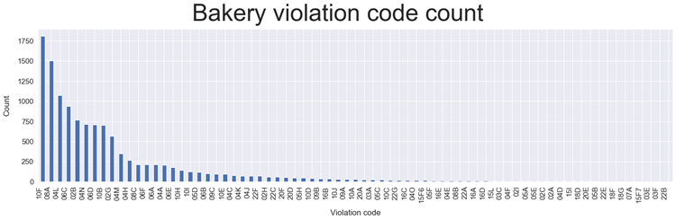
Common Violation Codes By Cuisine Type
10F: Non-food contact surface improperly constructed, maintained and/or not properly sealed, raised, spaced or movable to allow accessibility for cleaning on all sides, above and underneath the unit. Unacceptable material used.
06A: Personal cleanliness inadequate. Outer garment soiled with possible contaminant. Effective hair restraint not worn in an area where food is prepared.
04L: Evidence of mice or live mice present in facility's food and/or non-food areas.
06C: Food not protected from potential source of contamination during storage, preparation, transportation, display or service.
02B: Hot food item not held at or above 140º F.

Slide 5

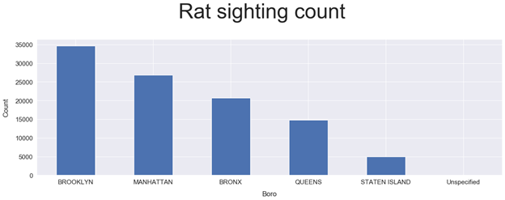
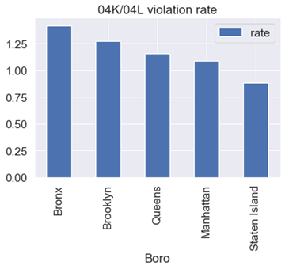
Rat Sighting vs Violation Code

Slide 6
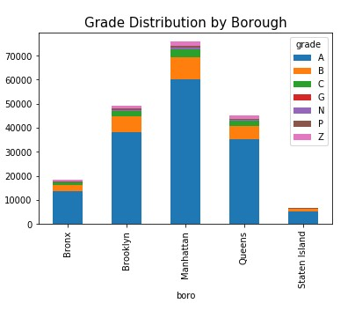
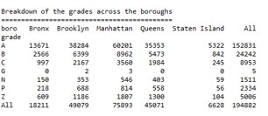
Grade Distribution by Borough

Slide 7
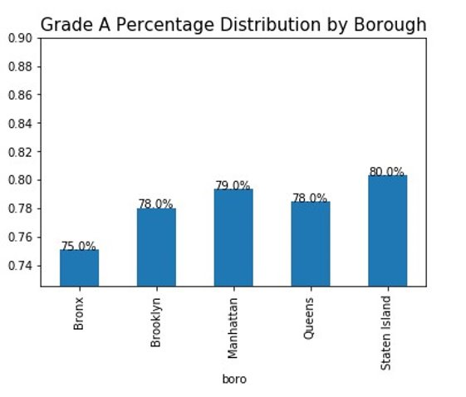

Slide 8

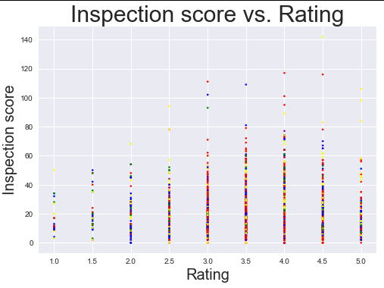
Yelp Rating vs Grade
Grade (Score) | Average Rating
A(0-13) | 3.722920
B(14-27) | 3.636350
C(>28) | 3.650132
red | Manhattan
green | Bronx
yellow | Brooklyn
blue | Queens
purple | Staten Island

Slide 9
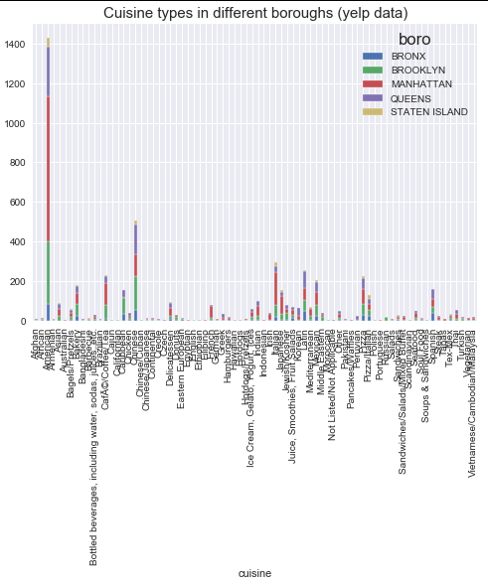

Slide 10
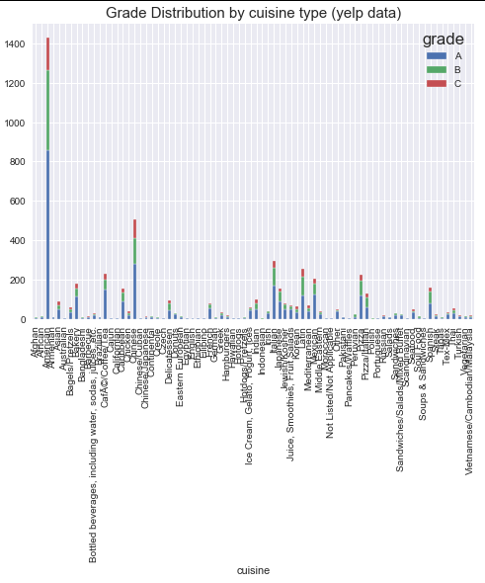

Slide 11
Questions?

Slide 12
Top 7 Common Violation Codes for Cuisine Types
Chinese | American | Bakery | Pizzaria | Fruit/Veggies
10F | 10F | 10F | 10F | 10F
08A | 08A | 08A | 08A | 04N
04L | 06D | 04L | 04L | 08A
06C | 10B | 06C | 02B | 06C
02B | 04L | 02B | 02G | 10B
02G | 04N | 04N | 06D | 04A
06D | 06C | 06D | 10B | 20D

